Slide 1
Basics of
WLAN
(Wireless LAN)

Slide 2
Wireless LAN
Wireless Local Area Network
It is the Data communication system that can use either infrared or radio frequency technology for transmission and receiving info.
Based on 802.11 standards. Set of IEEE standards for data transmission over WLAN’s.

Slide 3
Specifications for 802.11 &
Other Related IEEE Standards
802.11
WLAN operates at frequency 2.4 GHz
Data transmission rate of 1 Mbps - 2 Mbps
802.11a
WLAN operates at frequency 5. 0GHz
Data transmission speed up to 54 Mbps
802.11b
Widespread WLAN operates at frequency 2.4 GHz
Data transmission speed up to 11 Mbps

Slide 4
Specifications Cont.
802.11g
WLAN operates at frequency 2.4 GHz
Data transmission speed (over shorter dist.)
up to 54 Mbps
Why 802.11a?
  Greater bandwidth (54Mb)
  Less potential interference (5GHz)
  More non-overlapping channels
Why 802.11b?
  Widely available
  Greater range, lower power needs
Why 802.11g?
  Faster than 802.11b

Slide 5
Specifications (contd.)
Risks Involved in 2.4 GHz Frequency
One of the major issue using 2.4 GHz
range is that this range is already
crowded while used by microwaves,
cell phones, PDA’s, Blue tooth & etc.
so signal inference is a risk.

Slide 6
Advantages of WLAN
Simplicity of its installation or
Installation flexibility
Physical Architecture is quite simple
Mobility
Reduced Cost of Ownership

Slide 7
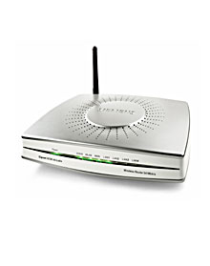
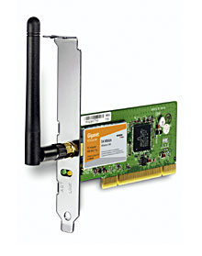
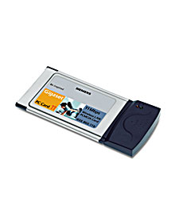
WLAN Components
Basic Components of a WLAN
Basic components are
Access Point (AP’s)
Network Interface Cards(NIC’s)/Client Adapters
PCI
PCMCIA

Slide 8
Components (contd.)
Access Point (AP’s)
AP is wireless equivalent of LAN hub It communicate with wireless devices by means of an antenna.
An AP operates with specific freq. Spectrum using 802.11 std.
It also inform wireless client of its availability and authenticates and associates wireless client to the wireless networks.

Slide 9
Components (contd.)
Network Interface Cards(NIC’s) / Client Adapter
Wireless Client Adapter connect PC to a wireless network either in ad-hoc mode or infrastructure mode.
It connect desktop and mobile computing devices to all network resources.
The NIC scan for available freq. spectrum for connectivity and associates with an AP.
It coupled to the PC operating system using a software driver.
Available in PCMCIA and PCI cards.

Slide 10
WLAN Architectures
WLAN or 802.11 networks operate in one of two modes
Ad-hoc or Independent Basic Service Set (IBSS)
Infrastructure mode or Basic Service Set (BSS)
Ad-hoc / (IBSS)
Networks without AP’s are called ad-hoc or peer to peer.
Stations communicate directly with each other.
Each computer in the LAN is configured at the same radio channel to enable peer-peer networking.

Slide 11
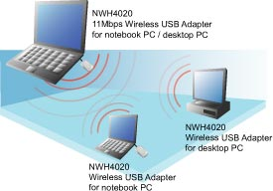
Architectures (contd.)
An Example of Ad-hoc Networks

Slide 12
Architectures (contd.)
Infrastructure / (BSS)
Wi- Fi Networks with an AP is called to be in infrastructure mode.
All network communication goes through an AP even if the two communicating peers are within the same coverage area.
AP acts as an Ethernet Bridge between the wireless media and wired network the AP is connected to.

Slide 13
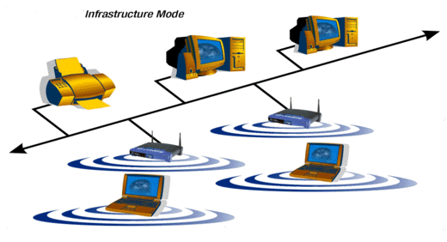
Architectures (contd.)
An Example of Infrastructure Networks

Slide 14
WLAN Basic Terminologies:
802.11 series | Most define physical/electrical and datalink characteristics of WLAN
WEP | Wired Equivalent Privacy – defined in 802.11
WPA | WiFi Protected Access (TKIP, Michael, AES) – subset of 802.11i
802.1X | IETF (RFC) standard for network authentication and key management
EAP | Extensible Authentication Protocol Used by 802.1X Requires specific auth method (EAP-TLS, MD5) PEAP – Protected EAP

Slide 15
Security Issues &
Threats

Slide 16
The list of main known security risks with 802.11:
Eavesdropping
Traffic Analysis
Data Tempering
Impersonating
Denial of Service
Wireless Client Attacks

Slide 17
Thank You..!

